Slide 1
WELCOME T0..

Slide 2

A Project Planning Report on “ANDRIOD QUIZ APPLICATION”
Submitted by
Aachal Borole
Under The Guidance of
Mr. D.O.Bharambe

Slide 3
CONTENTS
Introduction
Literature Review
Proposed Methodology
Implementation
User Manual
Discussion & Conclusion
Appendix
Format of Database
References

Slide 4
1. Introduction 1.1 Overview
The Android operating system is a mobile operating system that was developed by Google (GOOGL​) to be primarily used for touchscreen devices, cell phones, and tablets.
Android is an open source and Linux-based Operating System for mobile devices such as smartphones and tablet computers. Android was developed by the Open Handset Alliance, led by Google, and other companies.
Since Android is an operating system, its purpose is to connect the user and the device. For example, when a user wants to send a text, Android provides the user with a button to tap. When the user taps the button, Android directs the phone to send the text.

Slide 5
1.2 Objective
The main objective of “Quiz” is to facilitate a user-friendly environment for all users and reduces the manual effort.
Today, it may see that many people want to test their memory and general knowledge power. We help them doing so with the help of our small android app which allows them to to check their overall IQ.
One of the uses of mobile devices is “mobile learning”, which can be defined as “all kinds of learning that do not take place in certain predetermined fixed places”.

Slide 6
2. Literature Review
The goal of the present literature survey is to identify and compare existing test estimation techniques for traditional software (desktop/laptop) and for mobile software/application. The characteristics that make mobile software/application different from traditional software are identified in this literature survey.
The analysis of literature review suggests filling a research gap to present formal models for estimating mobile application considering specific characteristics of mobile software.
Android has two basic methods of security enforcement. Firstly, applications run as Linux processes with their own user IDs and thus are separated from each other. This way the one application does not affect other.

Slide 7
3. Proposed Methodology 3.1 Purpose of the project
This Project main purpose is to develop Quiz System named “Quiz Application” will provide quiz with multiple choice question (MCQ). This quiz application will support android base operating System.
The main package is android.database.sqlite that contains the classes to manage your own databases
Android comes in with built in SQLite database implementation. SQLite support all the relational database features.

Slide 8
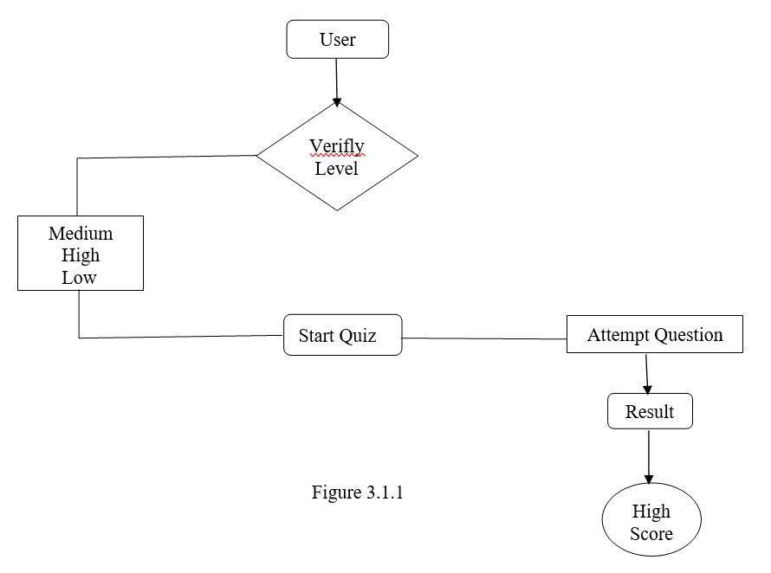
3.2 Flowchart

Slide 9
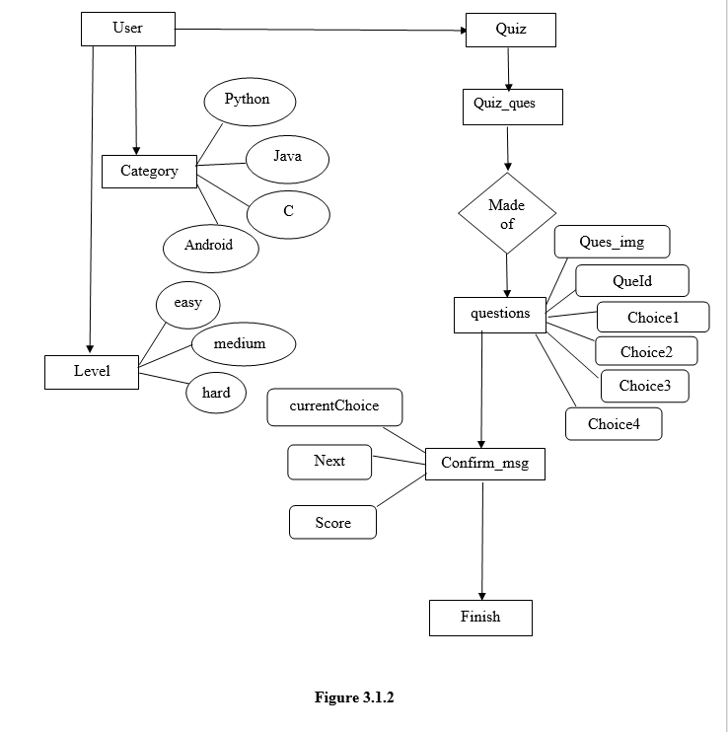
3.3 E R Diagram

Slide 10
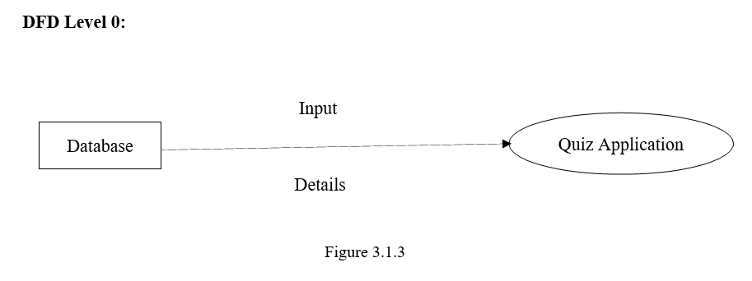
3.4 Data Flow Diagram DFD Level 0

Slide 11
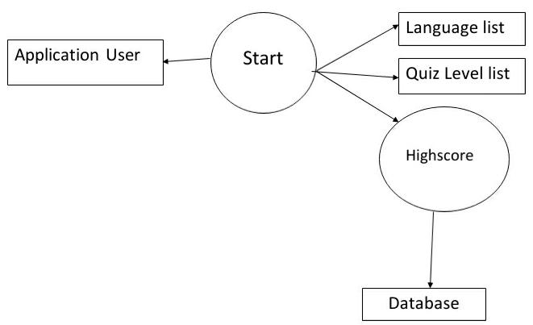
DFD Level 1

Slide 12
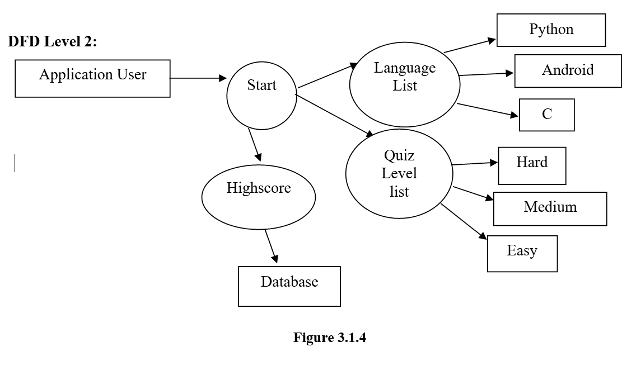
DFD Level 2

Slide 13
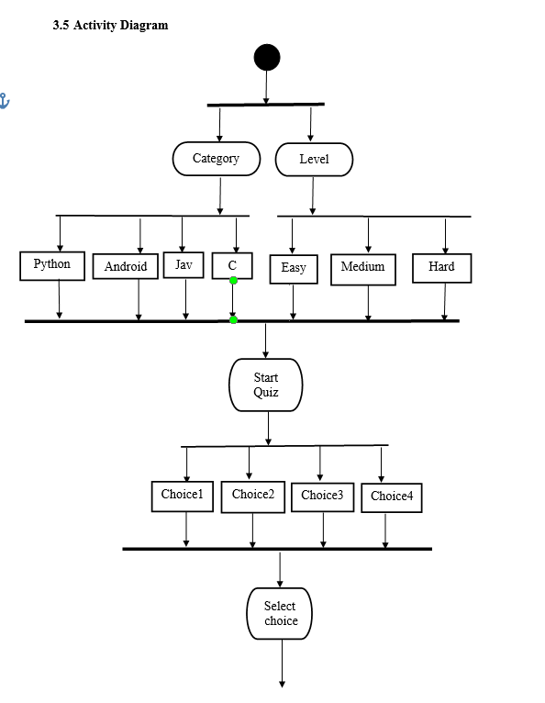
3.4 Activity Diagram

Slide 14
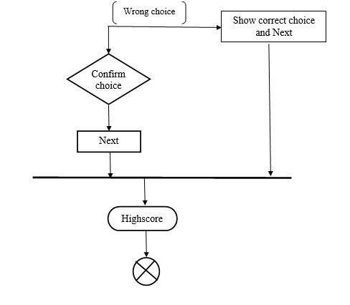

Slide 15
4. Implementation 4.1 Technologies Used
Microsoft Windows 10
Java Development Kit
Android SDK
SQLite Database
4.1.1 Microsoft Windows 10
Window 10 is personal computer operating system developed by Microsoft. It is a part of windows NT family of operating systems. 0Windows 10 released to manufacturing on 15 July 2015.

Slide 16
4.1.2 Java Development Kit
A java Development Kit (JDK) is a program developed environment for writing Java applets and application. It consists of a runtime environment that “sit on top” of the operating system layers as well as the tools and programming that developed need to compile, debug, and run.
4.1.2 Android SDK
The Android SDK (Software development Kit) is a set of development tools used to develop application for Android platform.
4.1.4 SQLite Database
SQLite is a open source SQL database that store data to a text file on a device. Android comes in with built in SQLite database implementation. SQLite supports all the relational database, you don’t need to establish any kind of connections for it like JDBC,ODBC etc.

Slide 17
4.2 Tools Used
4.2.1 Android Studio
Android Studio is the Integrated Development Environment (IDE) for Android app development.
Features:-
A fast and feature-rich emulator.
A unified environment where you can develop for all Android devices
Instant Run to push changes to your running app without building a new APK.
Extensive testing tools and frameworks.
Link tools to catch performance, usability, version compatibility, and other problems.

Slide 18
4.3 Database Design
Table 4.1.1 quiz_categories
 | -id | Name
 | Filter | Filter
1 | 1 | Python
2 | 2 | Android
3 | 3 | Java
4 | 4 | C

Slide 19
Table 4.1.2 sqlite_sequence
 | Name | Seq
 | Filter | Filter
1 | quiz_categories | 4
2 | quiz_questions | 117

Slide 20
Table 4.1.3 quiz_questions
 | _id | question | option1 | Option2 | Option3 | Answer_nr | Diffi Culty | category
1 | 1 | A | A | B | C | 3 | easy | 1
2 | 2 | B | A | B | C | 2 | Medium | 2
3 | 3 | C | A | B | C | 1 | Hard | 1
4 | 4 | D | A | B | c | 3 | Easy | 2
5 | 5 | E | A | B | c | 2 | medium | 3

Slide 21
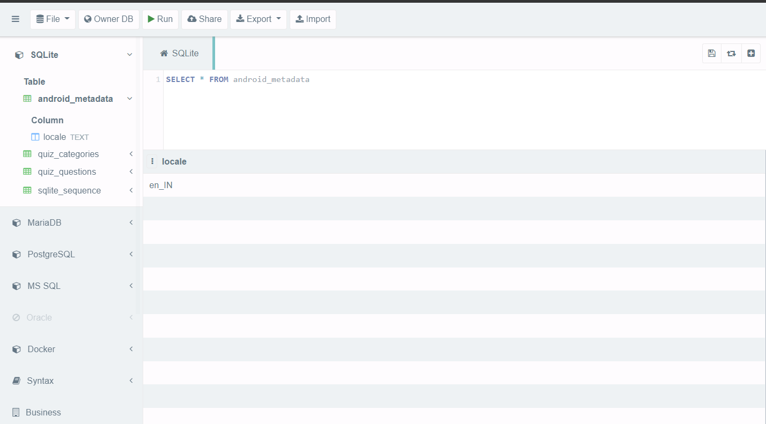
4.3 Database Format

Slide 22
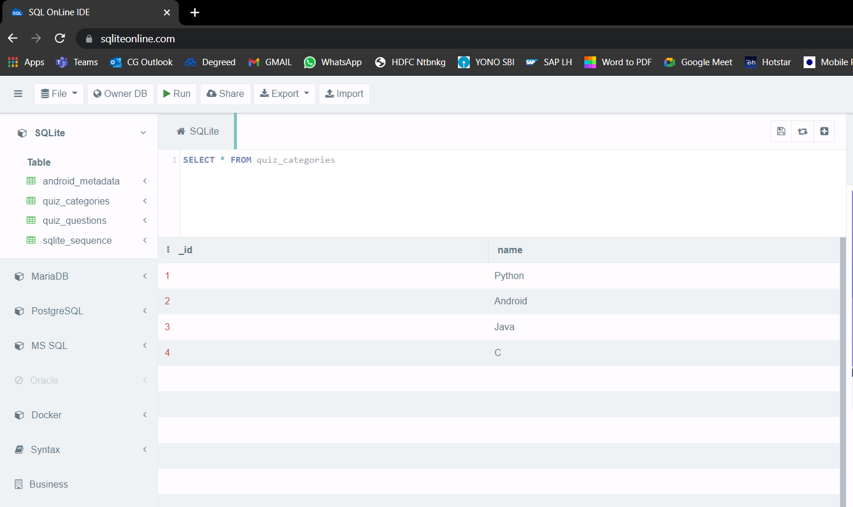

Slide 23
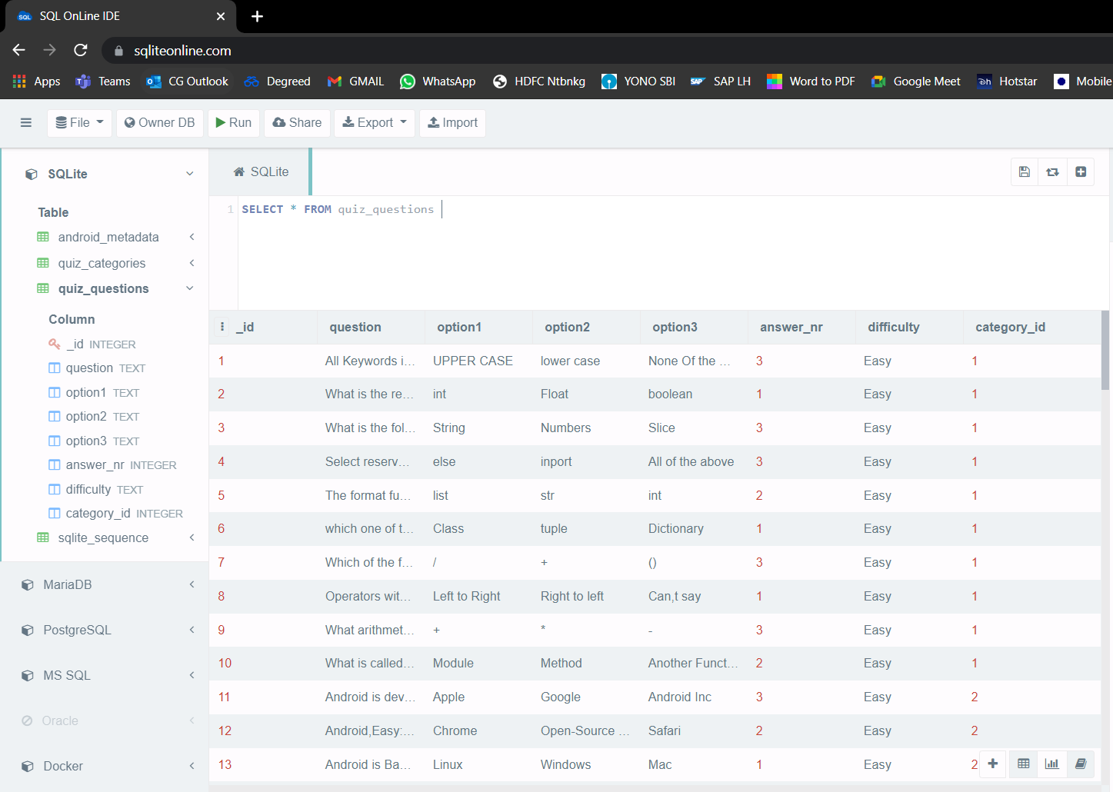

Slide 24
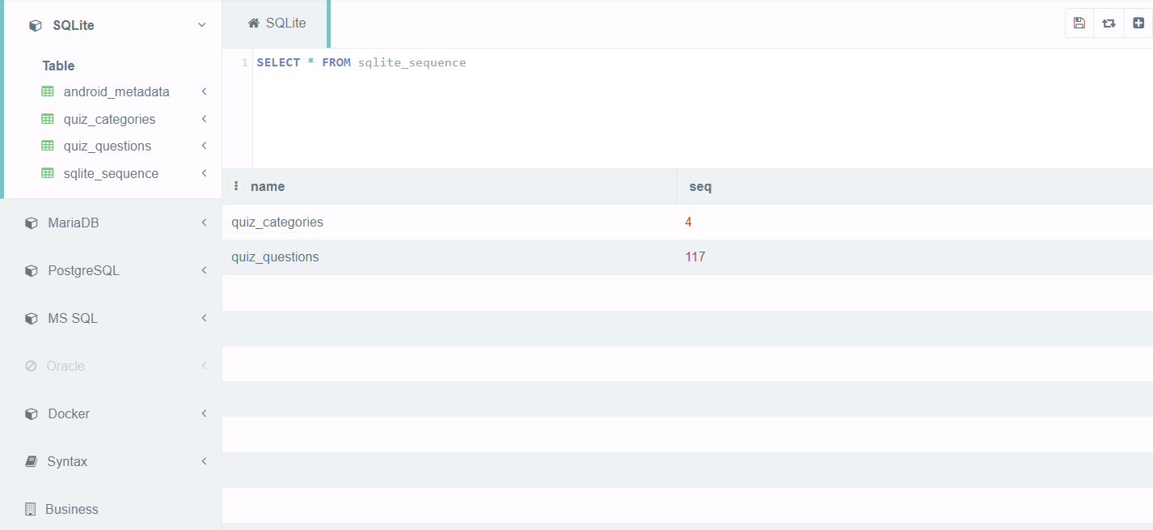

Slide 25
5. User Manual
Table 5.1.1 Minimum System Requirement
Device | Operating System (OS) | OS Version | RAM | Disk Space
Android Mobile/Tab | Android | 4.0.x to Higher | 64 MB or higher | 18 MB

Slide 26
5.2 Prrequisite
Internet Connection must active.

Slide 27
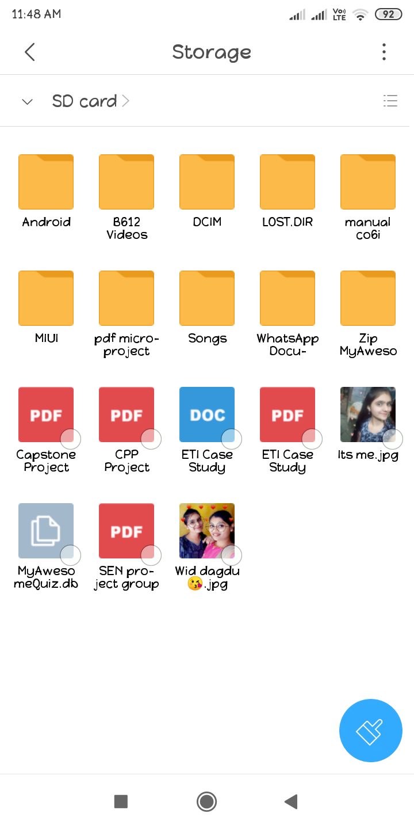
5.3 Installation 5.3.1 Installing android application in android smartphone

Slide 28
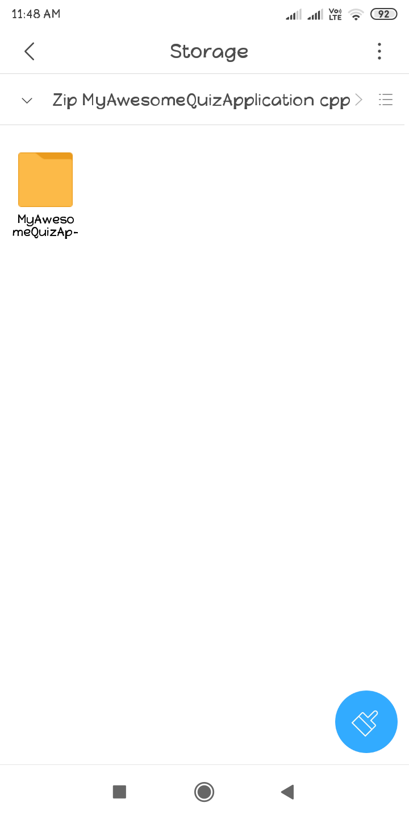

Slide 29
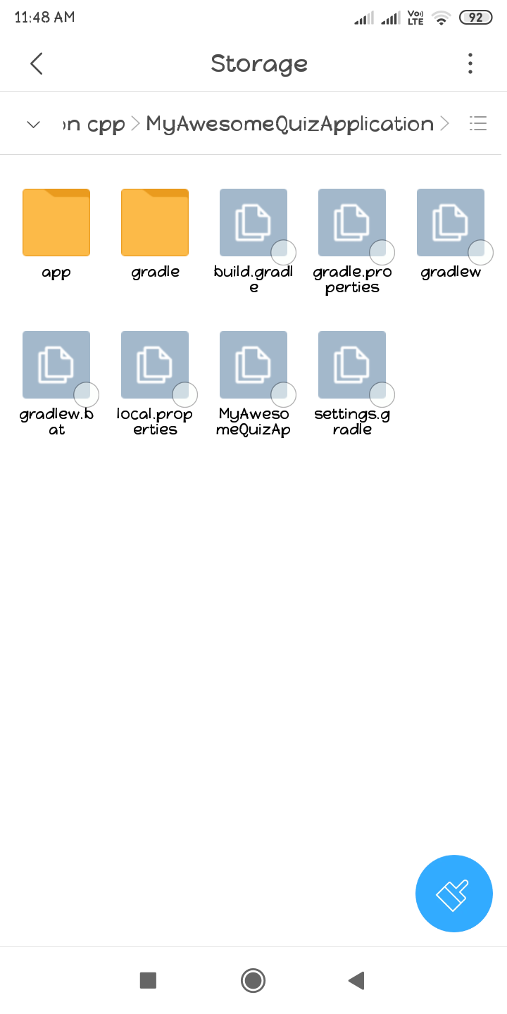

Slide 30
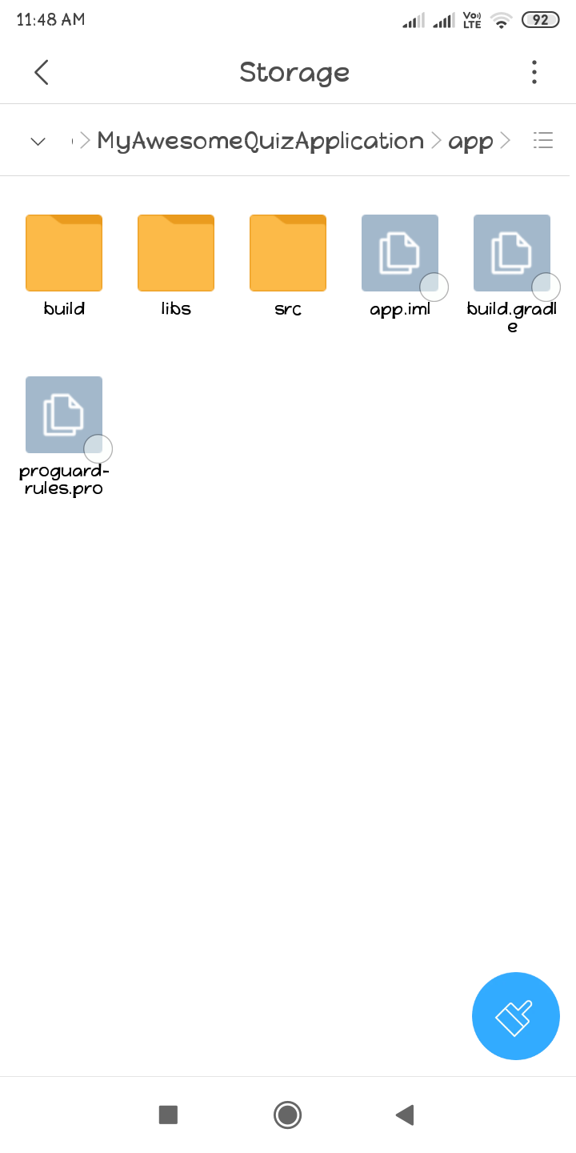

Slide 31
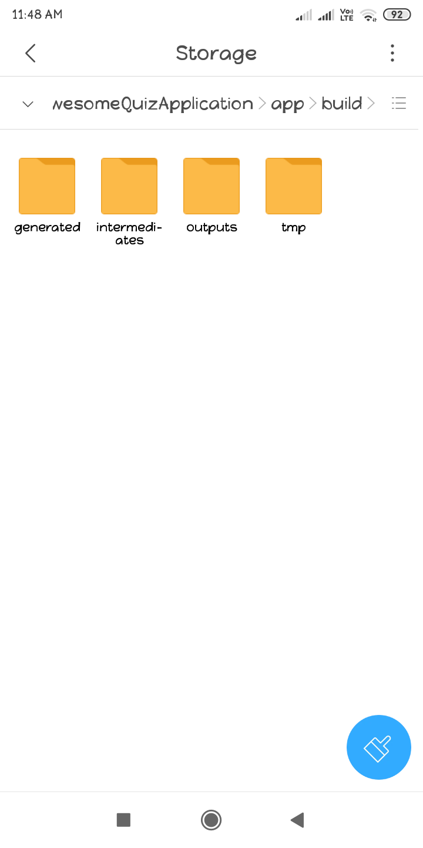

Slide 32
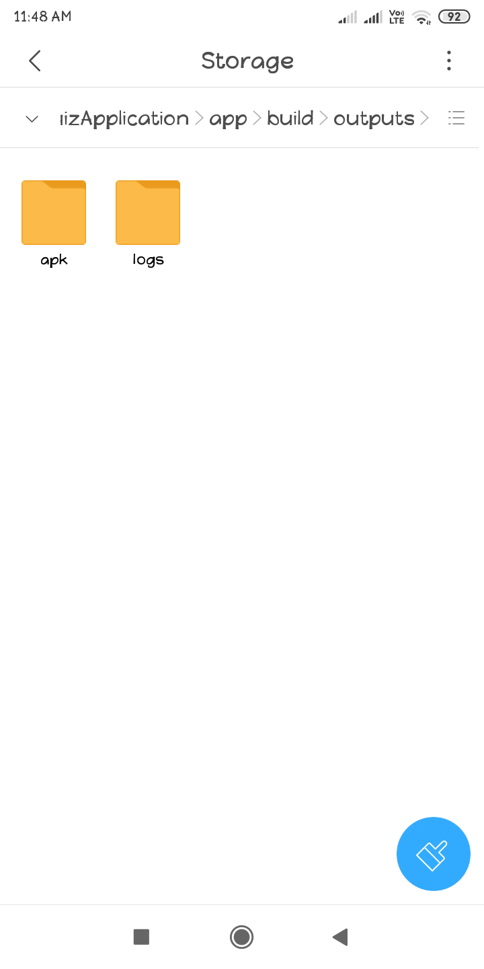

Slide 33
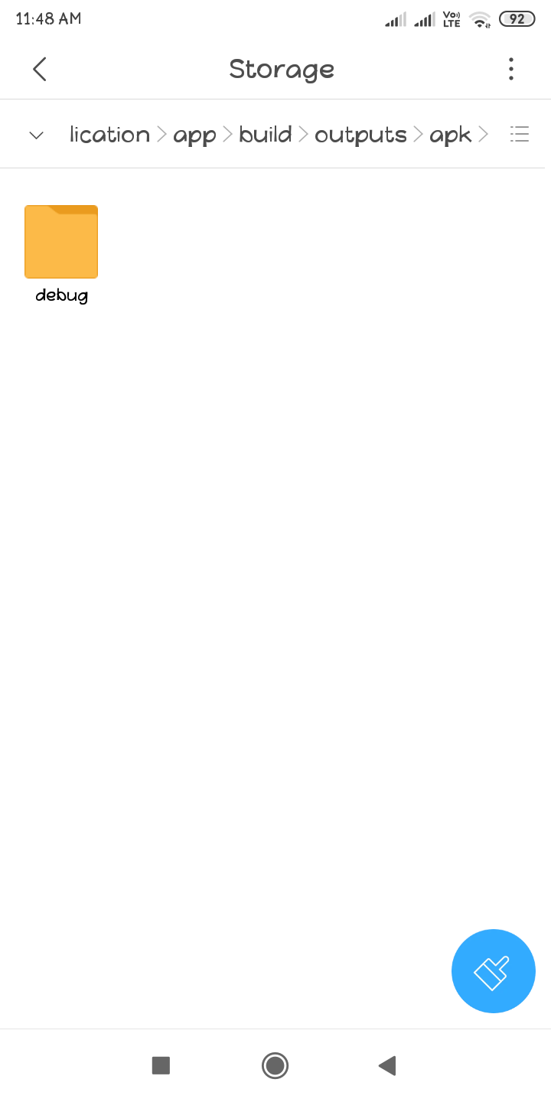

Slide 34
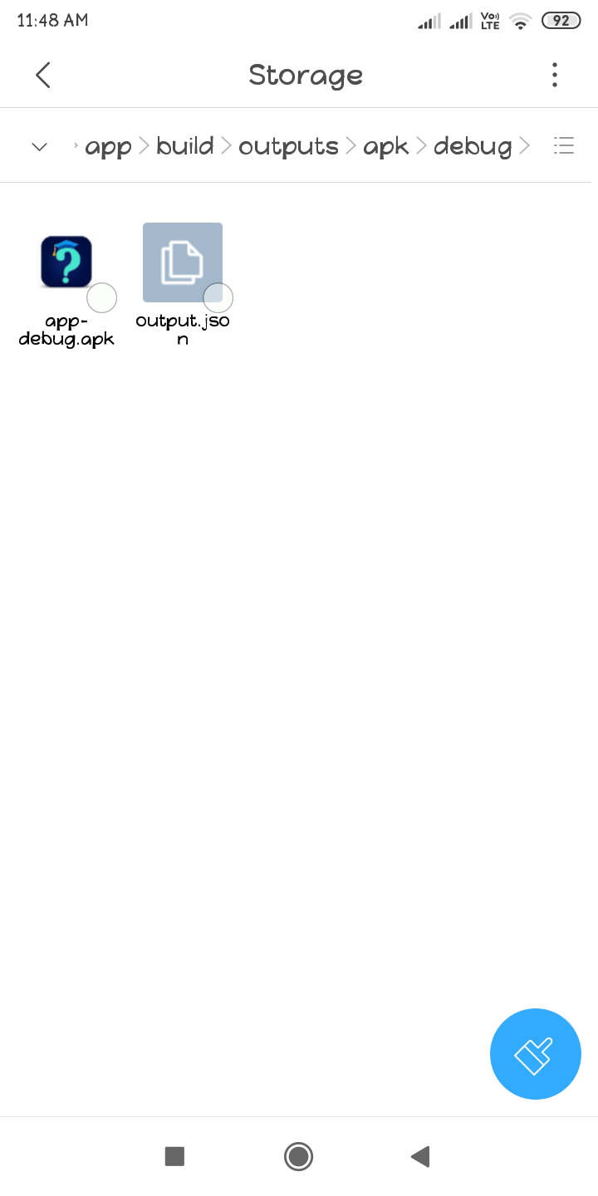

Slide 35
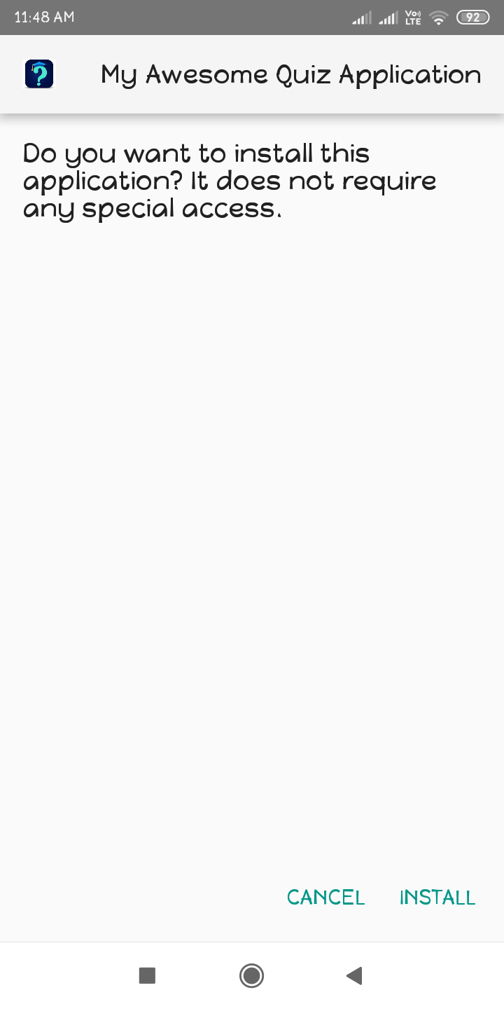

Slide 36
5.4 Getting Started
Tap the icon to open the application.
…………→

Slide 37
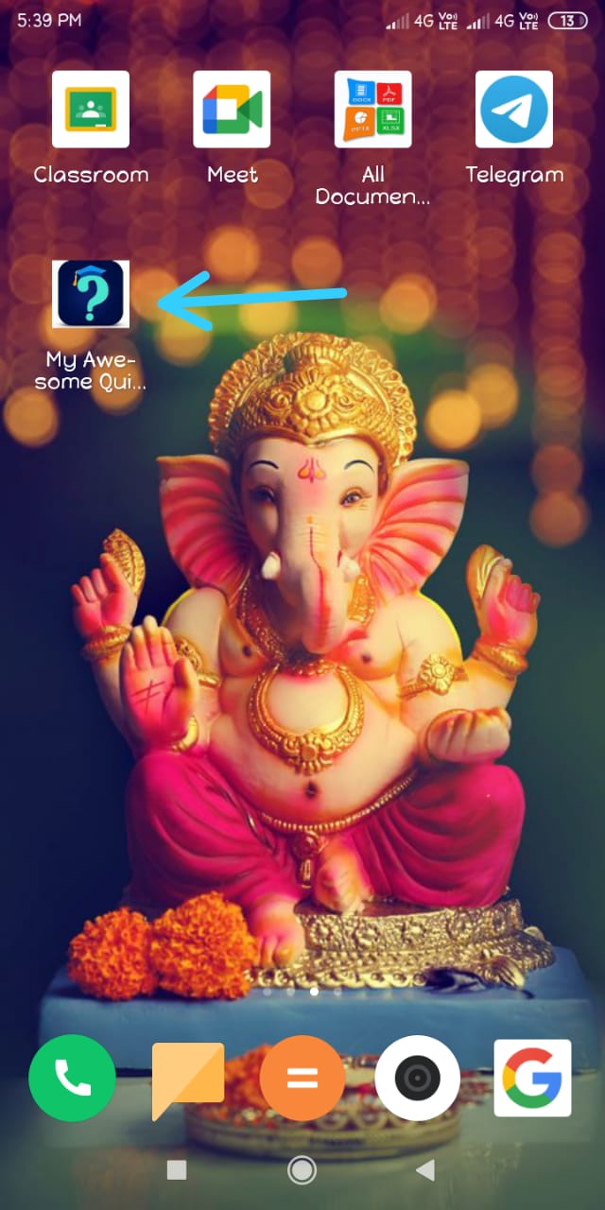

Slide 38
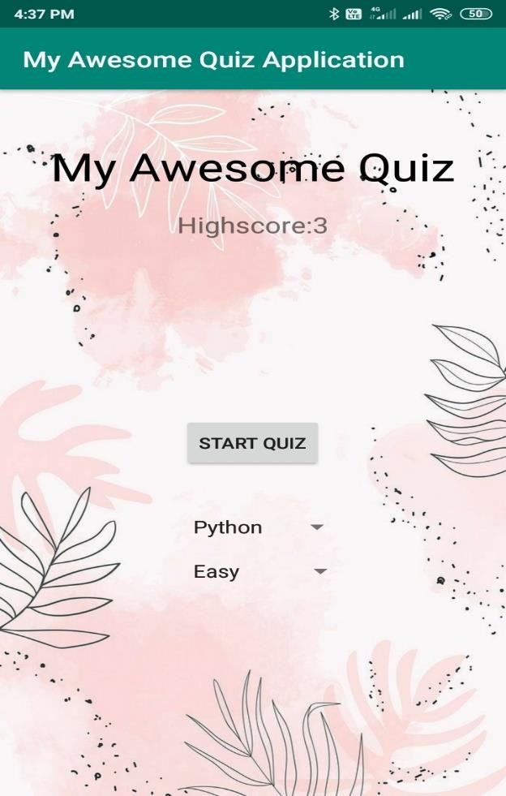
5.4.1 Home
Home screen will appear first, when the user start the app.
Figure 5.1.1 Home Page

Slide 39
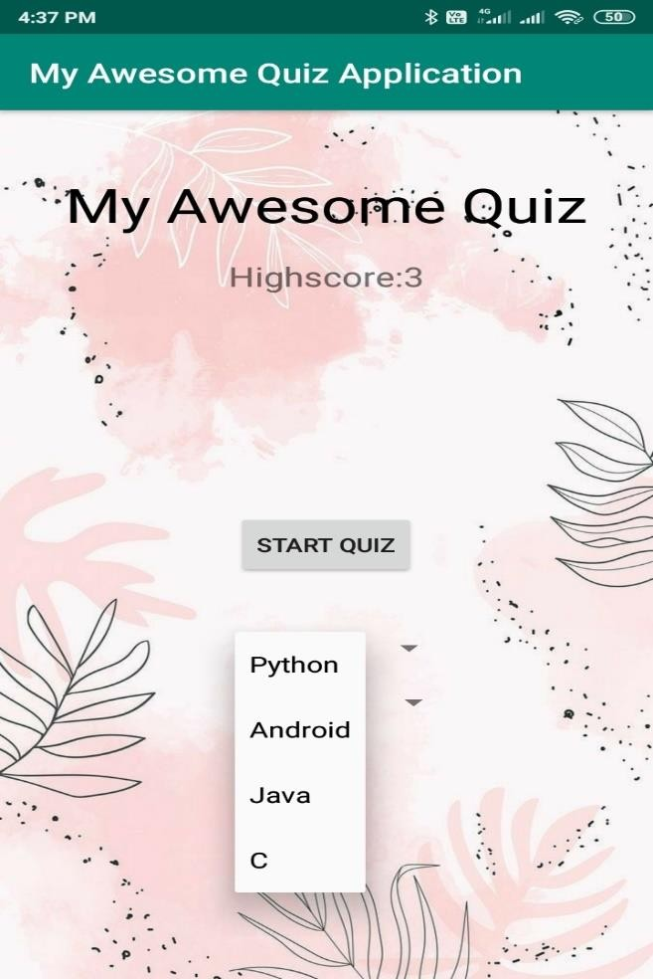
5.4.2 Choose Subject
Choose subject which subjects quiz you want to take.
Figure 5.1.2 Choose Subject

Slide 40
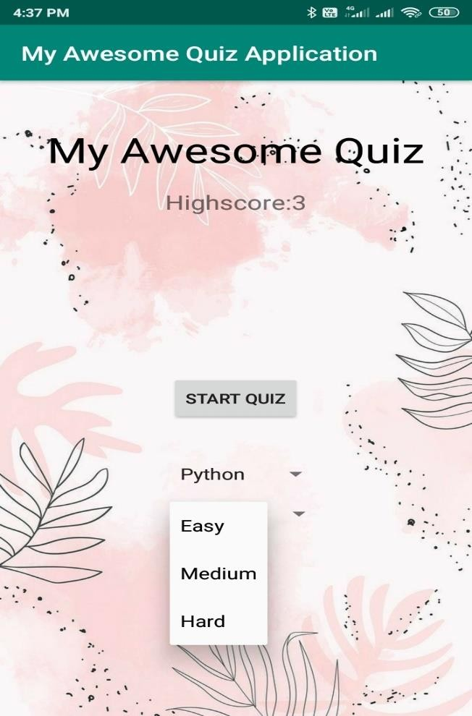
5.4.3 Choose Difficulty Level
Choose level which levels quiz you want to take.
Figure 5.1.3 Choose Difficulty Level

Slide 41

5.4.4 Start Quiz/ See High score
Click On Start Button for Starting the Quiz
Figure 5.1.4 Start Quiz

Slide 42
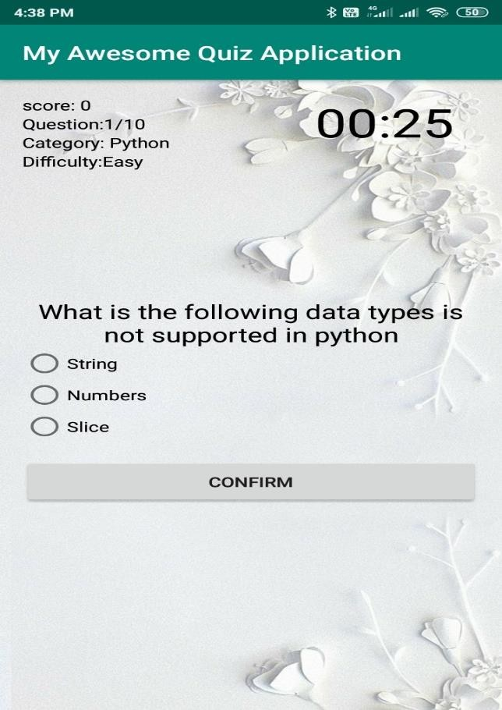
5.4.5 Sample questions
Questions are apperas on screen.
Figure 5.1.5 Sample Question

Slide 43

5.4.6 Result
See new High score on Screen.
Figure 5.2.2 High Score

Slide 44
6. Discussion & Conclusion
We’ve learnt through our research that Android is a much more diverse operating system than ios and windows Phone mobile. Android has grown rapidly over the past 4 year becoming the most used smartphone operating system in the world. It’s because Android doesn’t release 1 phone from 1 company with 1 new OS every Year. “QUIZ” software developed for a school or to a college has been designed for time reduction taken for conducting a quiz, for calculating the marks, for shortlisting the student’s name, hence increasing the efficiency. It is designed to replace an existing paper work and correction manually. It saves time as it allows number of students to give the exam at a time and displays the results as the test gets over, so no need to wait for the result. It is automatically generated by the server. Administrator has a privilege to create, modify and delete the test papers and its particular questions.

Slide 45
7. References
https://www.developer.android.com
https://www.google.com
https://www.tutorialpoint.com/android
https://www.javapoint.com/android-tutorial
Mr. Herbert Schildt , "The Complete Reference Java 2", Tata McGraw-Hill publication, 5rd Edition, 1998,1131
Mrs. Manisha Pokharkar & Mr. Prashant Somwanshi,” Mobile Application Developement”,”Nirali Publication”,1st Edition,2019,300.
Mr.”Neil Smyth”,” android Studio Development 3.2 Essential ”,“ Payload Media”, java edition, 2018,780.
https://www.quora.com
Mr.”ED Barnette”.”Hello Android”,”The pragmatic Bookself”,4th Edition,2017,500

Slide 46
Thank you…. : )

